Slide 1
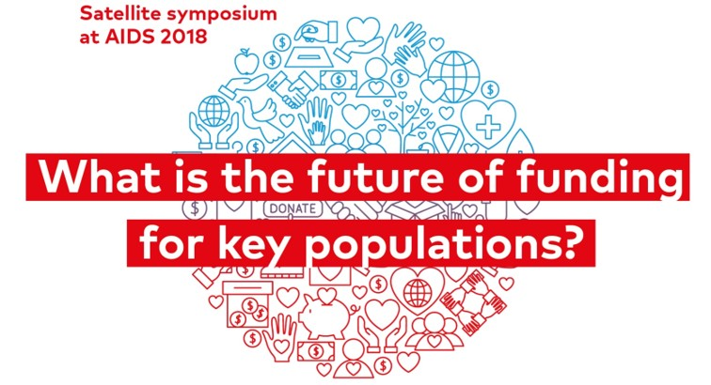
Notes:
Showing throughout the event

Slide 2
Go to www.menti.com and use the code 74 40 94
What percentage of HIV funding do you think is spent on key populations?
2%
5%
10%
25%

Slide 3
Opening Presentation Louise van Deth Executive Director | Aidsfonds

Slide 4
The Current State of Funding for Key Populations
KPs account for | : | 47% of new HIV infections globally 95% of new infections in regions outside Sub-Saharan Africa
KPs only get | : | 2% of all HIV funding 9% of prevention resources
KP funding | : | dropped by 18% from 2015 to 2016
Notes:
According to the most recent UNAIDS figures, key populations and their sexual partners account for 47% of new HIV infections globally. And 95% of new HIV infections in eastern Europe and central Asia and the Middle East and North Africa.
The risk of acquiring HIV is 27 times higher among men who have sex with men; 23 times higher among people who inject drugs; 13 times higher for female sex workers; 12 times higher for transgender women.
Yet according to AVERT, an estimated 2% of all HIV funding, and around 9% of resources allocated specifically for prevention, are spent on these groups.
And between 2015 and 2016, funding for key populations actually decreased by 18%, according to research by Funders Concerned about AIDS.
So the picture we can see undoubtedly gives us cause for concern; as community members, as implementers, as donors, as governments. Resources are not going where they are most needed.
References:
UNAIDS, July 2018 press release on the 2017 GLOBAL HIV STATISTICS
AVERT, May 2018
Funders Concerned about AIDS, TRACKING THE PHILANTHROPIC RESPONSE TO HIV AND AIDS 2016

Slide 5
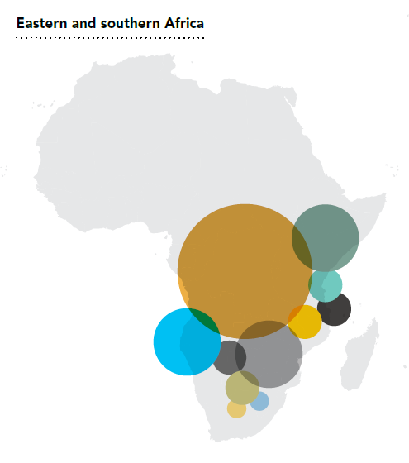
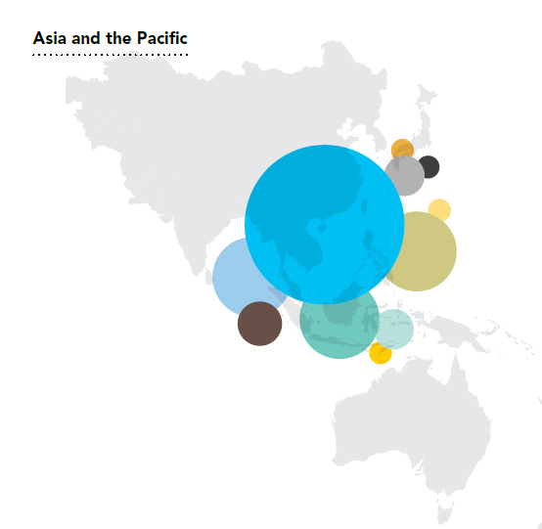
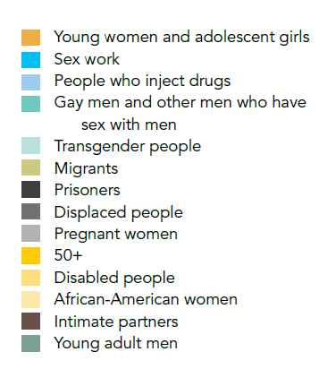
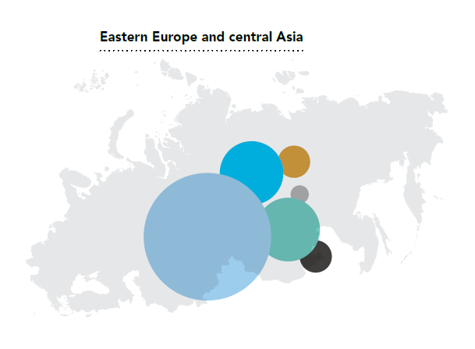

Slide 6
Funding for Community-Led Advocacy
Kenya |  | Indonesia
0.7 % of total Global Fund national grants (ca. $2,12m out of $296m) |  | 4% of total Global Fund national grants (ca. $3m out of $80m)
Notes:
We can zoom in on some recent figures from Kenya and Indonesia, which look at global fund investments in community-led advocacy. Advocacy which is critical to ensure that key populations have a voice at the table when it comes to the allocation of resources.
Between 2014 and 2017, just 0.7 % of total Global Fund national grants money in Kenya was allocated to community-led advocacy. This is $2,12 million out of a total of $296 million.
For Indonesia, this percentage was approximately 4%, which amounts to approximately $3,38 million out of $80 million.
HOWEVER the question we need to ask: is this amount enough to contribute towards removing structural barriers?
Reference:
PITCH: INVESTING IN COMMUNITY LED ADVOCACY TO END AIDS: Global Fund investments in community led advocacy in Kenya and Indonesia 2014-2017, 2018

Slide 7
Funding for Sex Workers
Community-led action is crucial!
Only 17% of sex worker-led organisations access multilateral funding
70% of funding for sex worker rights comes from foundations
Little available funding for policy development, advocacy, legal services
Notes:
Looking at one key population – sex workers – the evidence consistently shows that longer term, structural, community led interventions are key to increase access to prevention and treatment for sex workers, However, funding for these groups are still extremely limited.
Human rights work plays a vital role in protecting populations most affected by HIV. However, only US$137 million is spent annually on the global human rights response to HIV, accounting for just 0.13% of all HIV spending in low- and middle-income countries. And from this amount, only a fraction actually reaches sexs workers
In addition, among the funding available for sex workers groups, funding for policy development, rights-based advocacy and legal representation and legal services are the hardest and least funded type of resources available
Sex work groups also struggle to access funding from multilateral agencies such as The Global Fund and UN agencies, only 17% of sex work organisations are able to do it
This also means that majority of funding for sex workers groups come from public foundations.
References:
Decker, MR, Crago, A-L, Chu, SKH et al. Human rights violations against sex workers: burden and effect on HIV. The Lancet. 2014; published online July 22: http://dx.doi.org/10.1016/S0140- 6736(14)60800-X; and UNDP (2011): Analysis of Key Human Rights Programmes in Global Fund supported HIV Programmes. Available at: http://www.undp.org/content/undp/en/home/librarypage/hiv-aids/analysis-of-key- human-rights-programmes-in-global-fund-supported-hiv-programmes.html.UNAIDS
UNAIDS. “Sustaining the human rights response to HIV” 2015, http://www.unaids.org/sites/default/files/media_asset/JC2769_humanrights_en.pdf
Red Umbrella Fund: Funding for sex workers rights, 2014
Ibid

Slide 8
The Information Gap
HIV spending in low and middle income countries
$19 billion per year
Domestic governments
$11 billion
Bilateral donor funding
$5,6 billion
Donor governments to Global Fund / Unitaid
$1,6 billion
Key populations
$ ???
Key populations
$ ???
Philanthropic donors
$680million
Key populations
$87,5 million
People who inject drugs
$21,1 million
MSM (+TG)
$47,9 million
Sex workers
$18,4 million
MSM (+TG)
$ ???
MSM (+TG)
$ ???
MSM (+TG)
$ ???
Sex workers
$ ???
Sex workers
$ ???
Sex workers
$ ???
People who inject drugs
$ ???
People who inject drugs
$ ???
People who inject drugs
$ ???
Key populations
$ ???
Notes:
We see not only a funding gap, but also a significant data gap in the available information on funding for key populations. How much do domestic governments and bilateral donors spend on key populations? We simply don’t know.
We want to know how much funding from the total spent in low and middle income countries - $19bn – makes its way to key populations.
We do know, for example, from research from the Kaiser Family Foundation that funding from philanthropic donors (87% of all funding) accounts for $680m of that, and the breakdown per key population is illustrated. We also know, according to the Red Umbrella Fund, that €9.1 is spent on sex worker rights per year.
But the picture is incomplete.
What also know that, external funding remains the only source of funding for key populations in many countries. Even in countries like Botswana, which has nearly reached the 90-90-90 targets, it is critical key population groups where HIV prevalence and infection rates are highest that are not being supported by national funding.
One valuable outcome from this event would be a commitment to conduct the research necessary to complete this funding picture. Which would be a first step towards ensuring that sufficient funding is available for key populations.

Slide 9
Notes:
Showing throughout the event

Slide 10
Go to www.menti.com and use the code 74 40 94
Which statement do you most agree with?
Funding key population led responses to HIV is the most effective way to counter the epidemic
Funding key population responses to HIV is important, but there are more efficient ways to get to the end of the epidemic

Slide 11
Go to www.menti.com and use the code 74 40 94
How long should key populations be supported (by non-governmental actors) after the Global Fund has exited a country?
1 year
5 years
10 years
Indefinitely

Slide 12
Closing Remarks Christine Stegling Executive Director | International HIV/AIDS Alliance

